Slide 1
Confusion Matrix

Slide 2
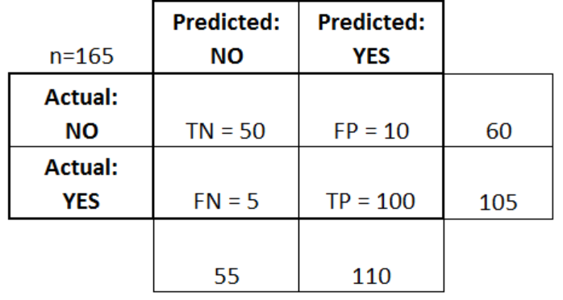

Slide 3
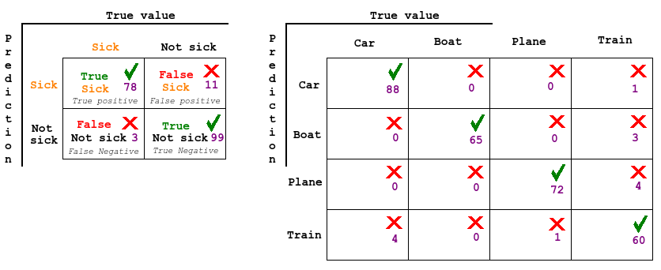

Slide 4
true positives (TP): These are cases in which we predicted yes (they have the disease), and they do have the disease.
true negatives (TN): We predicted no, and they don't have the disease.
false positives (FP): We predicted yes, but they don't actually have the disease. (Also known as a "Type I error.")
false negatives (FN): We predicted no, but they actually do have the disease. (Also known as a "Type II error.")

Slide 5
This is a list of rates that are often computed from a confusion matrix for a binary classifier:
Accuracy: Overall, how often is the classifier correct?
(TP+TN)/total = (100+50)/165 = 0.91
Misclassification Rate: Overall, how often is it wrong?
(FP+FN)/total = (10+5)/165 = 0.09
equivalent to 1 minus Accuracy
also known as "Error Rate"
True Positive Rate(a.ka.a. Sensitivity): When it's actually yes, how often does it predict yes?
TP/actual yes = 100/105 = 0.95
also known as "Sensitivity" or "Recall“
True Negative Rate(a.ka.a. Specificity): : When it's actually no, how often does it predict no?
TN/actual no = 50/60 = 0.83
False Positive Rate: When it's actually no, how often does it predict yes?
FP/actual no = 10/60 = 0.17
equivalent to 1 minus False Positive Rate
Precision: When it predicts yes, how often is it correct?
TP/predicted yes = 100/110 = 0.91
Prevalence: How often does the yes condition actually occur in our sample?
actual yes/total = 105/165 = 0.64

Slide 6
